Slide 1
Excel Data Cleaning Project
(Week 1)

Slide 2
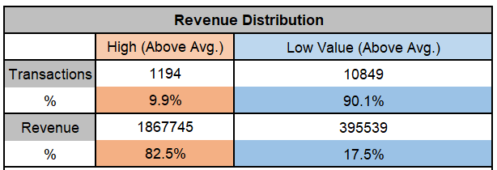
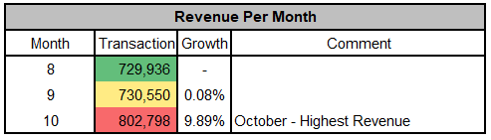
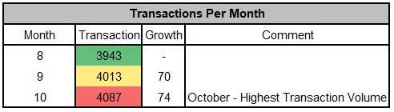
Business Performance Insight
Business is driven by OCCASIONAL LARGE transactions.
Revenue is GROWING monthly.
Transactions are also GROWING monthly.

Slide 3
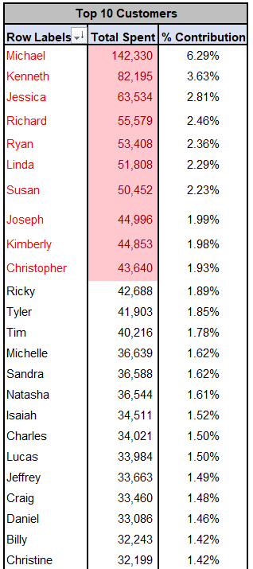
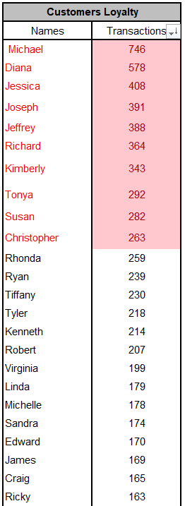
Customer-Level Insight
Top 30% of the customers contributes 50% of the revenue.
Most customers are repeat buyers ~ LOYAL. Top Customers with many transactions ~ RETENTION PLAN

